Slide 1
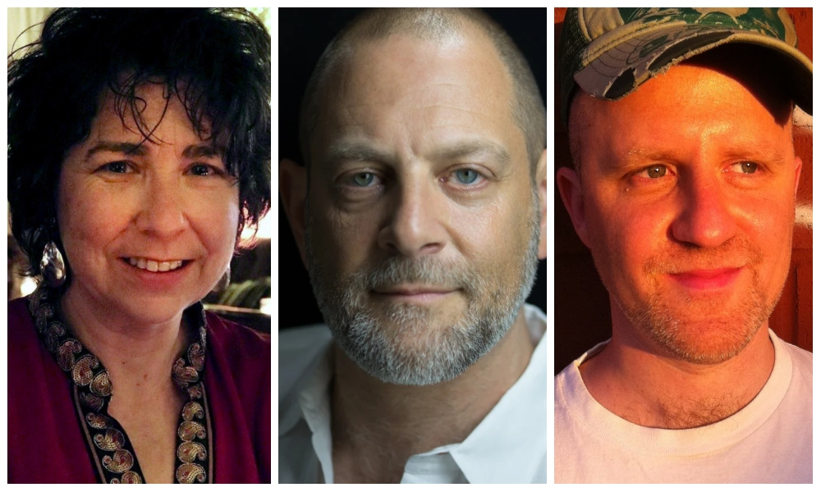
MOMENTLIVE!
Sabbath Queen
Aimee
Ginsburg Bikel
Amichai Lau-Lavie
Sandi DuBowski
momentmag.com

Slide 2
